Slide 1
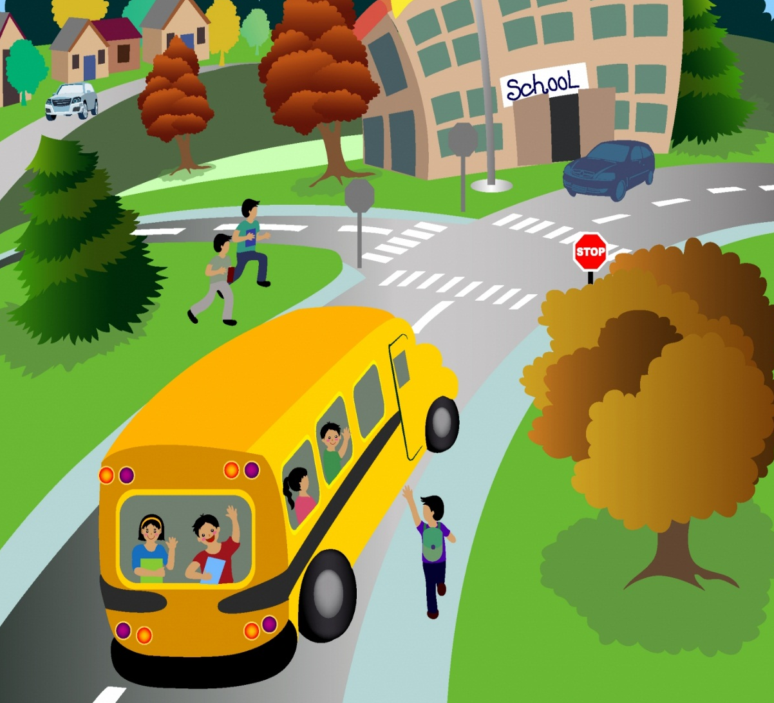
TRACER- MY SAFE TRAVEL
Safe Secured and Verified Transportation of Students

Slide 2
School Bus Tracking and Student Attendance System
My Safe Travel can help you make your student transport safer using latest technologies. We understand that the Schools are under constant pressure to provide a safe, reliable service to the students and their parents and also to raise profits for the fleet owners.
My Safe Travel provides a highly automated and customizable School bus safety solution to reduce the stress on the drivers as well as on the transportation department of the School.

Slide 3
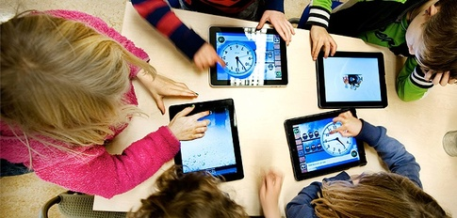
Why School Bus Tracking?
Child Safety
In today's scenario, avoiding any mishap with the children has become an important issue for both the parents and school management. Hence we provide RFID based School Bus Tracking Solution through which one can easily monitor the school bus along with the students in it so that you never lose sight of your child. It is a one stop solution for live tracking, route management, automated SMS, emergency preparedness, student attendance and more. MY SAFE TRAVEL emphasizes on accuracy, efficiency, safety and security and has no match in these dimensions. Ensuring the safety of your children can never get easier and more effective.
Be in the League of Technologically Advanced Schools
Convert your buses into smart-buses by using the state-of-the-art GPS tracking technology for the safety of the students. The schools enforcing such systems are preferred by parents for offering such distinguished services. It reflects the technically sound and modern nature of the institution.

Slide 4
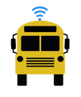
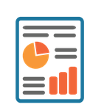
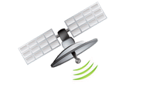
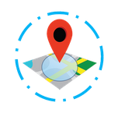
Features
Speed Alerts
Worry no more about keeping a tab on errant drivers, get instant email, SMS alerts when the School Bus over speeds with location and speed details along with graphical visuals.
Emergency Management
In case of any emergency, just select the Bus route and get the details of students like blood group and contacts.
In Bus Attendance
Attendance of the student is updated on the Tracer cloud application using the RFID reader by passive tag methods.
Manual mass SMS notice filtered as per bus route standard and section can also be sent using Tracer application.
Downloadable Reports
All reports with respect to attendance, bus location, speed, stoppage, history and other details can be downloaded or printed through the Tracer application.
Live Tracking
What is more exciting than looking at the School bus travel live on the map with a default refresh rate of 15 secs, hence giving more insight to the safety.
Pick/ Drop SMS
Automated Pick/ Drop and arrival alerts are sent to parents mobile.
Geo Fencing
Now make virtual fences on your map and get SMS and email alerts if the School Bus leaves any designated geo fenced area.
Ignition/ Stoppage Report
Idling and unnecessary stoppages for the convenience of the driver is a burden which the school or transport company has to bear. With smart-reports this issue can be taken care of.
Driver Analysis
Get automated reports about the driver behaviour and he will be rated accordingly based on keeping up time, speed violations and driving habits.

Slide 5
How it Works?
School Bus fitted with MY SAFE TRAVEL device and RFID reader
Location details from the satellite is received on our MY SAFE TRAVEL GPS tracker module
Location Detail along with Student attendance from RFID is transmitted via GPRS or 3G from our MY SAFE TRAVEL GPS & RFID devices
Data from the MY SAFE TRAVEL device is received on our server through cellular network, which is stored for analysis.
Alerts are sent via SMS and email to parents and transport managers.
View live Bus location details, student attendance and other reports from anywhere using our MY SAFE TRAVEL cloud based application.

Slide 6
How It Helps
SAFETY
Track all buses in real-time so parents can be notified of the actual arrival time, minimizing the time children have to wait, exposed to bad weather or other dangers. Alerts can also be set up so that fleet managers receive a message the instant buses enter a no-go zone or drivers engage in unsafe driving.
COST-SAVINGS
Monitor the driving patterns to make sure drivers operate their vehicles efficiently, eliminating unnecessary idling, observing speed limits and not taking detours. And because GPS tracking is considered as an anti-theft device by most insurance companies, you can save on insurance premiums, too.
TIME
Avoid time-consuming manual collection of fleet activity needed for state reports and compliance. With GPS tracking, this information is automatically collected and reported, which saves time and minimizes errors for both drivers and fleet managers.

Slide 7
How It Helps…
Better Maintenance
Improve the regularity and timeliness of preventative maintenance with automatic GPS tracking on vehicles. Know in advance when the servicing is due, to minimize downtime and unwanted breakdowns as well as to allow sufficient time to schedule substitute buses. Accurate mileage tracking also means better warranty recovery another cost saving.
Environmental accountability
Optimize routing and track engine idling to minimize the impact on the environment, trim pollutant emissions, and reduce your fleet's carbon footprint. Proudly report your 'green fleet' metrics to parents making your fleet more likely to be the vendor of choice.
Tender successfully
GPS tracking not only makes a fleet more profitable, it also benefits the students, parents and government agencies. By highlighting the benefits of real-time GPS tracking, school bus companies ensure a greater chance of winning the tender.
:

Slide 8
User Advantage
For Students and Staff
Prior intimation to students/staff that bus is approaching pickup point, hence ensuring on-time pickup.
Parents can prepare themselves to receive their children as they return.
For School Transport
SMS alerts to parents/dear-ones.
Over-speeding alerts.
Total distance and total time travelled.
Live view of all buses on Google map.
For Driver
The driver/conductor adopts a common trend of dialling the students/staff before the bus reaches the pickup point. The Tracer-SBT SMS facility takes care of this issue and helps the driver concentrate on driving rather than diverting his attention towards dialling the students/staff.
For Parents
SMS alerts to parents/dear-ones informing them that student has boarded the bus at pickup with timings.
Reached school with timings.
Left school with timings.
Alighted the bus at drop point with timings.

Slide 9
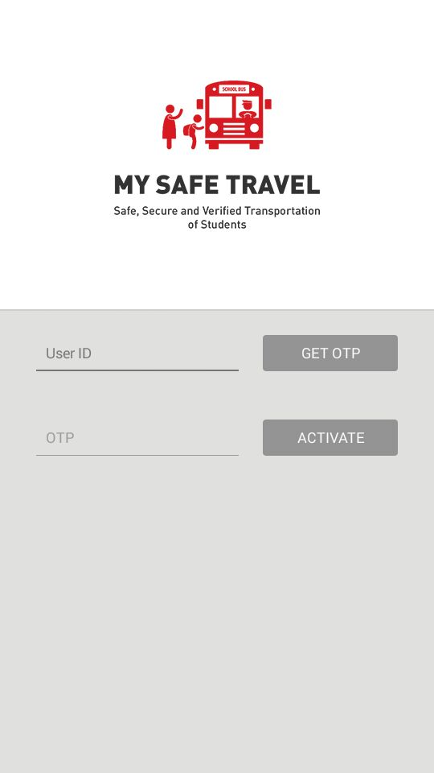
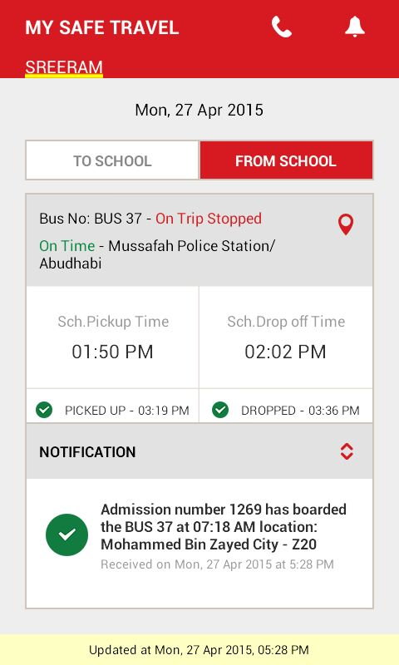
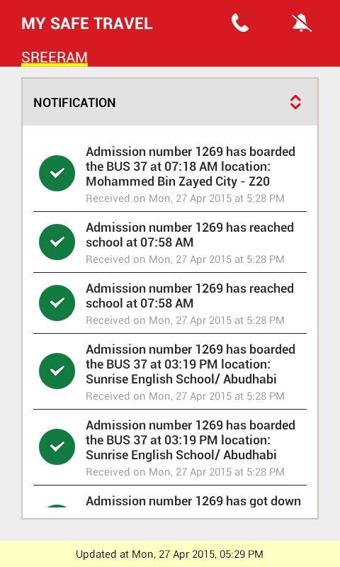
Student Tracking App for Parents
One Touch Access
Stay Informed
Stay-in-Touch
Receive Alerts

